Slide 1
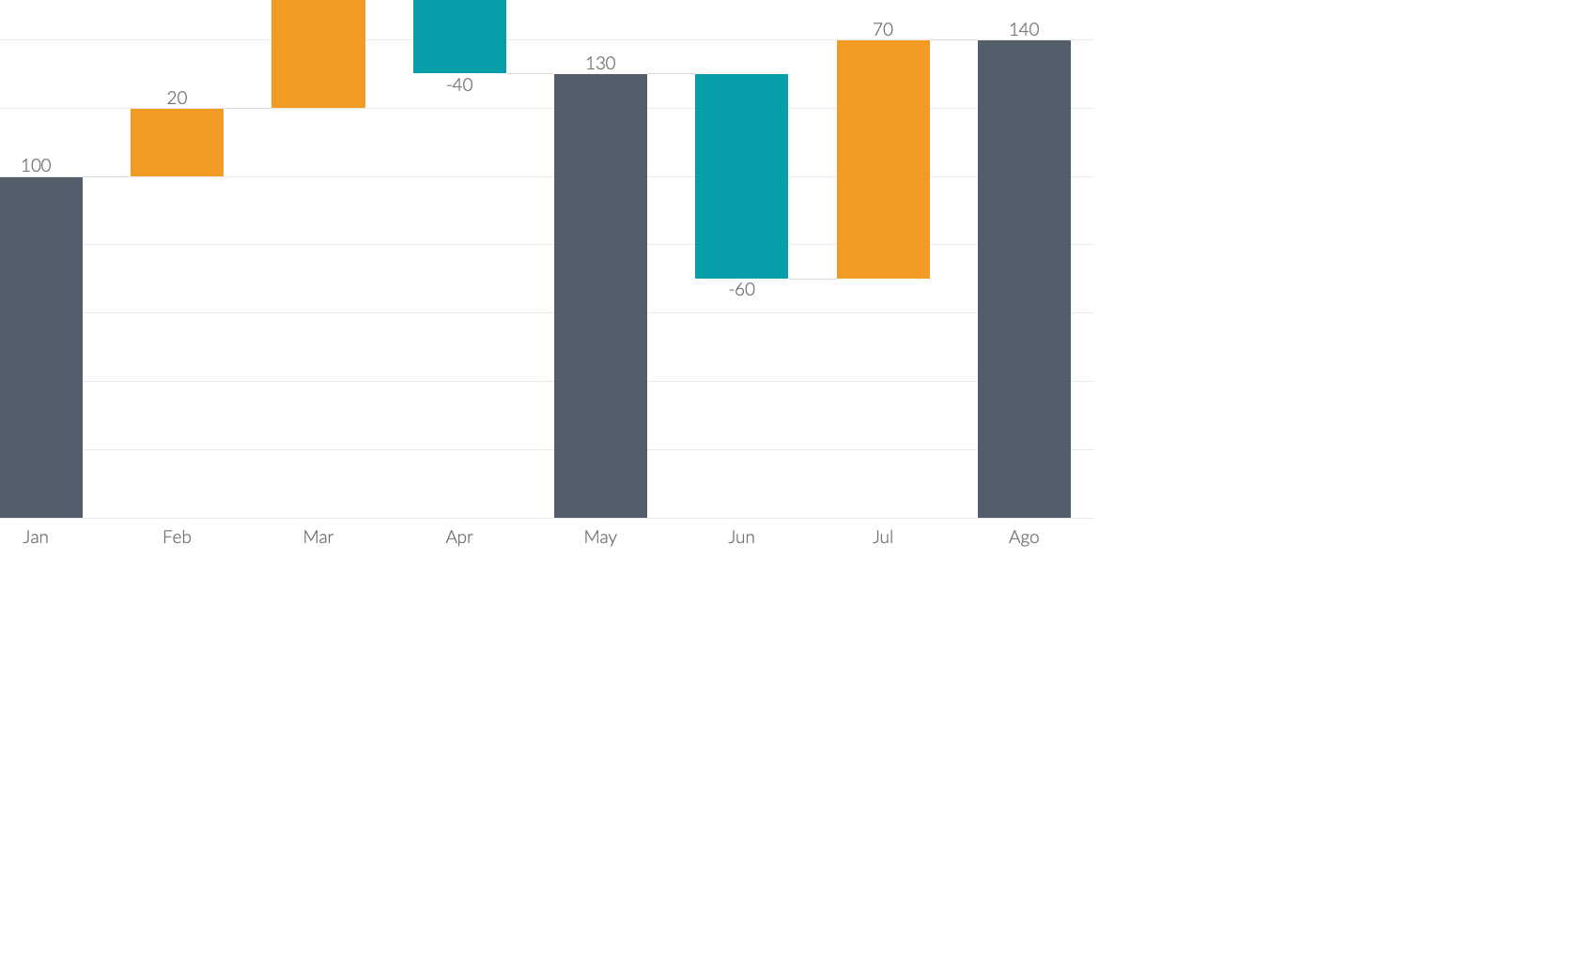
Waterfall Charts
Marketing is the study and management of exchange relationships. Marketing is the business process of creating relationships with and satisfying customers.
Increase
To get your company’s name out there, you need to make sure.
Decrease
To get your company’s name out there, you need to make sure.
Total
To get your company’s name out there, you need to make sure.

Slide 2
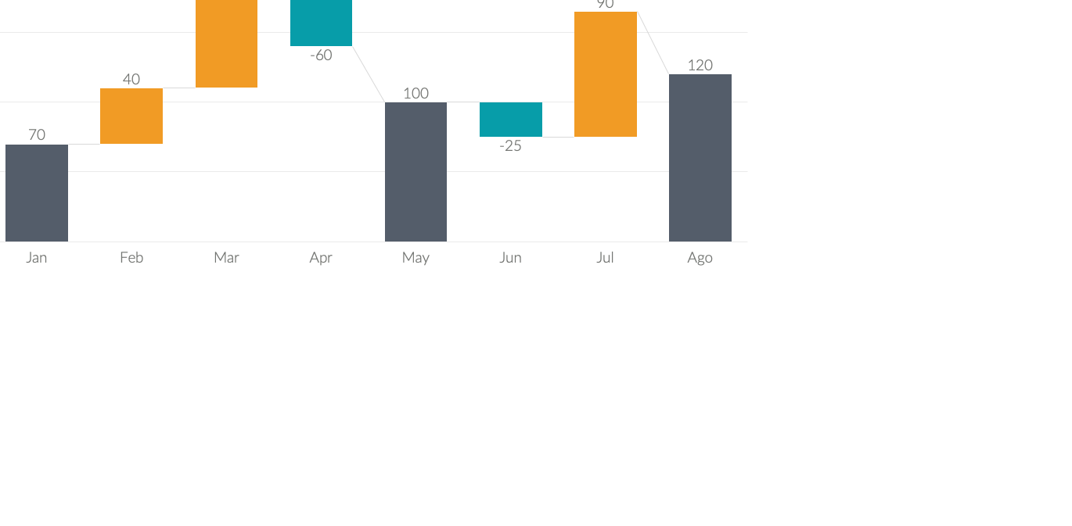

Waterfall Charts
Marketing is the study and management of exchange relationships. Marketing is the business process of creating relationships with and satisfying customers.
Increase
Decrease
To get your company’s name out there, you need to make sure marketing.
To get your company’s name out there, you need to make sure marketing.

Slide 3
Waterfall Charts
Marketing is the study and management of exchange relationships. Marketing is the business process of creating relationships with and satisfying customers.
Increase
To get your company’s name out there, you need to make sure marketing.
Decrease
To get your company’s name out there, you need to make sure marketing.

Slide 4
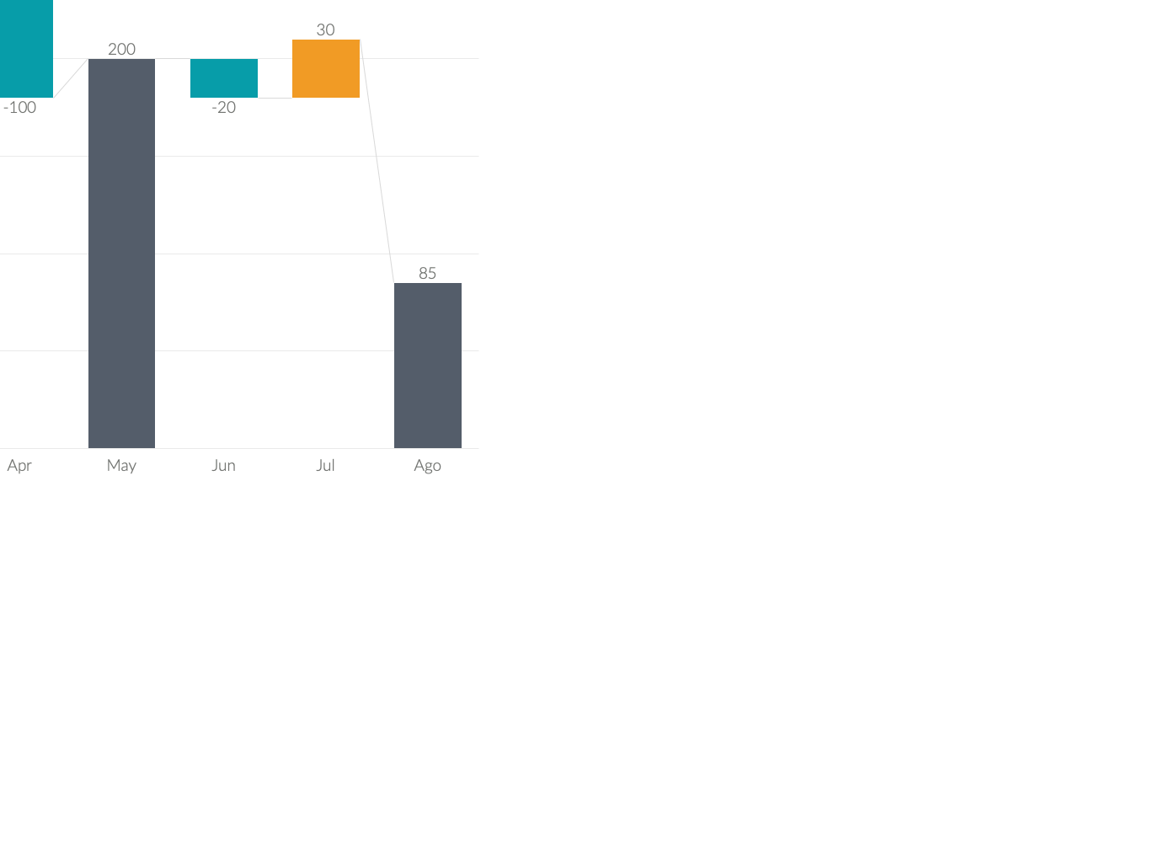
Waterfall Charts
Marketing is the study and management of exchange relationships. Marketing is the business process of creating relationships with and satisfying customers.
There are people who have a significant number of followers in every business domain on social media.
These influencers create detailed content that provides useful information.
We offer small businesses a complete array of online marketing solutions to fit any budget.
Increase
Decrease
Total

Slide 5
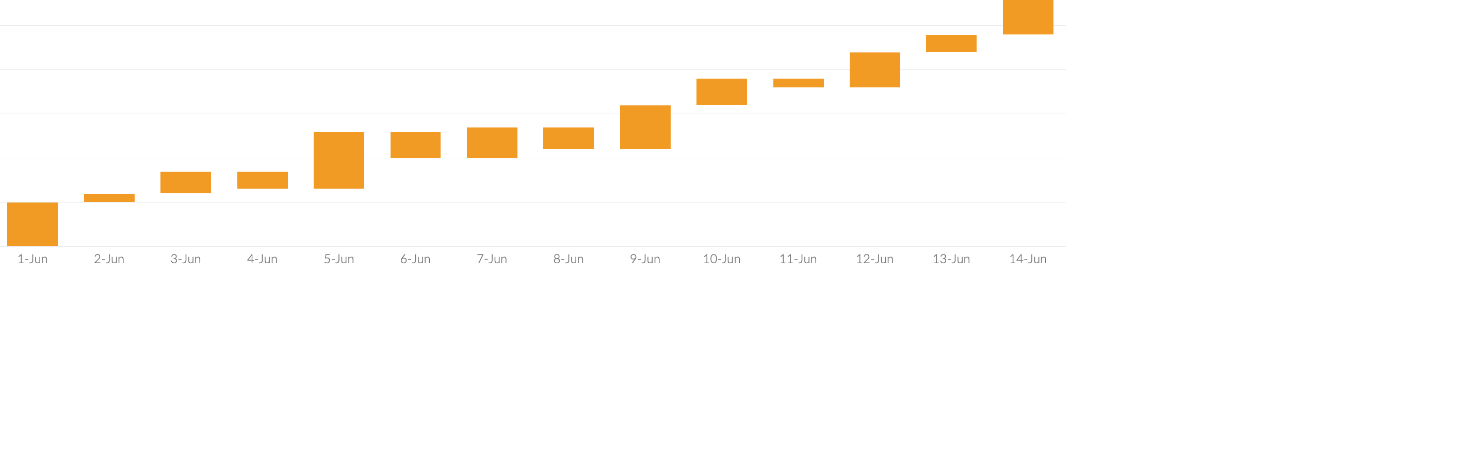
Waterfall Charts
Marketing is the study and management of exchange relationships. Marketing is the business process of creating relationships with and satisfying customers.
There are people who have a significant number of followers in every business domain on social media.
There are people who have a significant number of followers in every business domain on social media.

Slide 6
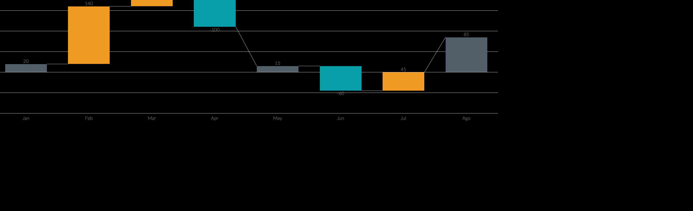
Waterfall Charts
Marketing is the study and management of exchange relationships. Marketing is the business process of creating relationships with and satisfying customers.
Marketing
Desire
Awareness
There are people who have a significant number of followers in every business domain on social media.

